Slide 1
Prediction Analysis for Crop Production

Slide 2
Problem Statement
To Predict the paddy production(Tons) in different states based on the area used for producing paddy crop & consider the year in which we’re doing the prediction.

Slide 3
Project Flow
Build Multiple Linear Regression model using training data.
Input Data
Data Pre-processing
Split data into training & testing data.
Do predictions on test data using the trained multiple Linear Regression Model.
Deploy the model using Flask application in UI.
Scatter plot predicted & actual values

Slide 4
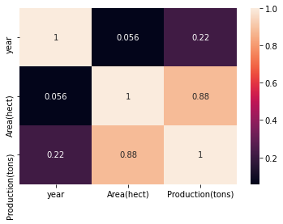
Findings
In the correlation matrix, we found out that there is no correlation between year and production features.

Slide 5
Findings
We also found that as area is increasing, production of paddy crop is also increasing irrespective of the year and state in which we are producing the paddy crop.

Slide 6
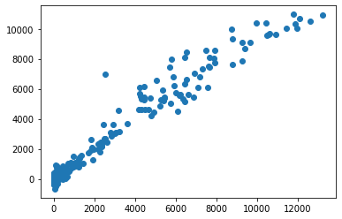
Findings
After training the Multiple linear regression model & predicting the production on unseen data, we interestingly found that the actual & predicted values are almost near to each other.

Slide 7
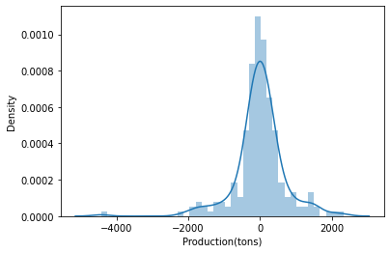
Findings
After training the Multiple linear regression model & predicting the production on unseen data, we found that 95% of the data in distribution plot of difference between predicted & actual values lie around zero(0) which means our predicted values are very near to the actual values.

Slide 8
Drawbacks
Major drawback is not considering the features like climatic conditions, Soil conditions, pesticide usage, water quality etc., which influences the paddy production in any state.

Slide 9
Conclusion
Our rigorously trained Multiple linear regression model will help us in predicting the total paddy production(Tons) in particular state, particular year & particular Area(hectares).

Slide 10
Citations

